Slide 1

Assistive Agents for Self-Represented Litigants
Prof. Matthew Gerber¹, Mark Rucker¹ ¹University of Virginia
February 15, 2018

Slide 2
Need and Industrial Relevance
Legal Services Corporation (LSC) reported that 86% of low-income Americans with civil legal problems did not have access to adequate legal help [1].
Barriers to receiving legal help extend beyond institutional resources, however. Only 18% of low-income Americans even sought legal help for civil issues, suggesting this is also an education and marketing problem [1].
The LSC estimated that their annual appropriations would need to increase from $0.3 billion to $1.6 billion to meet all needs [2].

Slide 3
Project Goals
Meet legal needs without increasing federal spending
Give truly helpful and personalized assistance to SRLs
Connect SRLs with attorneys and courts when needed
Assistive Agent
Courts
Attorneys
Self Represented Litigants

Slide 4
Objectives
Advance modelling techniques for Cyber-Human Systems
Show feasibility for online, personalized, knowledge services
Explore the micro-macro duality of combining IRL with ABM

Slide 5
Our Approach (Research Method)
Hypothesis: Capturing an SRL’s objectives is key to personalized process insights, improved attorney-litigant matching and smart recommendations.
Data: Currently using synthetic data from an ABM. We are in the process of acquiring naturalized SRL data.
Analysis: From the data an MDP is designed to capture system dynamics. Using the MDP, agents can be viewed as Reinforcement Learners with recoverable objectives.
Current Results: Using IRL we have extracted artificial agent objectives and demonstrated these objectives are sufficient to fully explain observed agent behavior

Slide 6
Challenges
Limited domain data about self-represented litigants has made further advancements towards product/application difficult
Furthermore this approach works best with a unique data structure. Unfortunately, this means many existing data stores which have been created with supervised learning applications in mind don’t fit well.

Slide 7
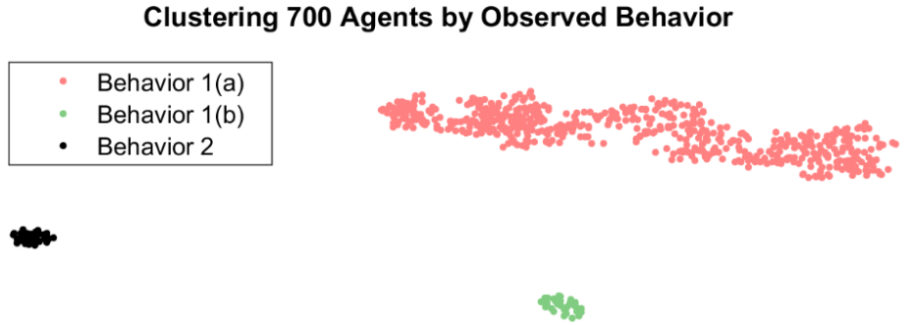
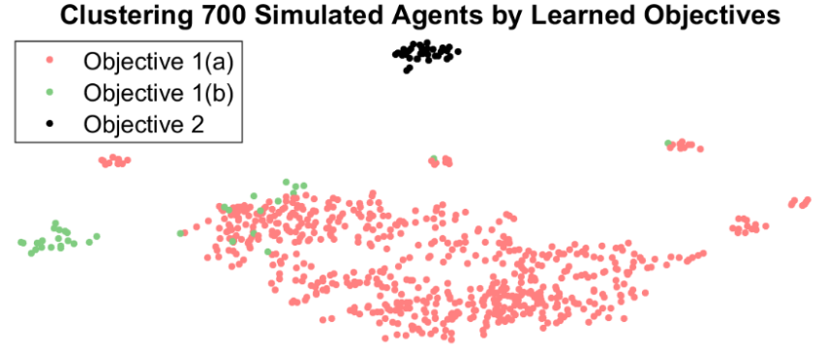
Conclusions
Using the synthetic data we were able to recreate the entire system with only observations of individual agent behavior
Technique is able to naturally capture the non-independent nature of the observations as well as the time of the data.
Analysis of individual agent behavior also matched known ground truth (known because the data had been created)
Statistical analysis of simulated behavior. There are three clear groups even though two groups are known to share objectives
Analysis of objectives learned from simulated behavior. Here we see group 1 (a) and (b) begin to look similar despite different behaviors above

Slide 8
References
[1] 2017 Justice Gap Report
[2] Documenting The Justice Gap In America 2009
[3] Legal Services Corporation Funding (https://www.lsc.gov/about-lsc/who-we-are/congressional-oversight/congressional-appropriations)

